Slide 1
Cyber Security and Australia's Law and Policy Patchwork LAWS8077 – CYBER LAW
Dr Damian Clifford damian.clifford@anu.edu.au

Slide 2
SEMINAR OVERVIEW
Policy documents and developments
Demonstrating the legal patchwork
Cybercrime
Critical infrastructure protection
Data protection/privacy
Commercial contracts.
Exercise
Q&A

Slide 3
Some key policy documents
Australia’s Cyber Security Strategy 2020
The Australian Government discussion paper on options for regulatory reforms and voluntary incentives to strengthen the cyber security of Australia's digital economy, Strengthening Australia's cyber security regulations and incentives.

Slide 4
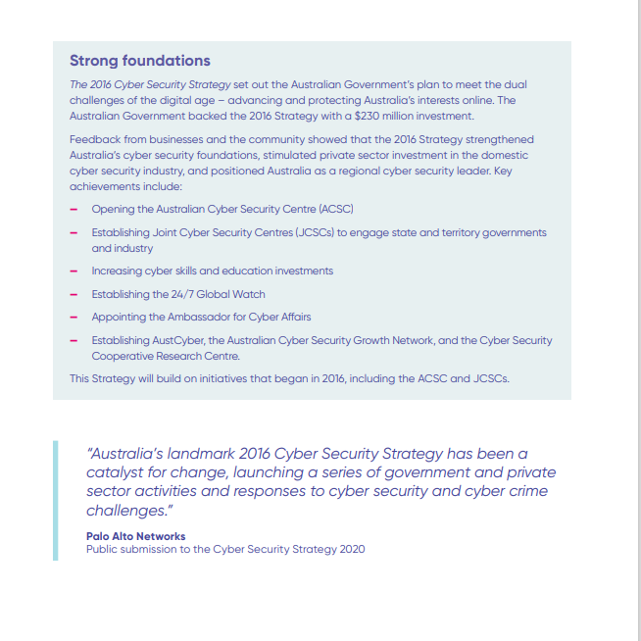
Some key policy documents
Australia’s Cyber Security Strategy to Australia’s Cyber Security Strategy 2020.

Slide 5
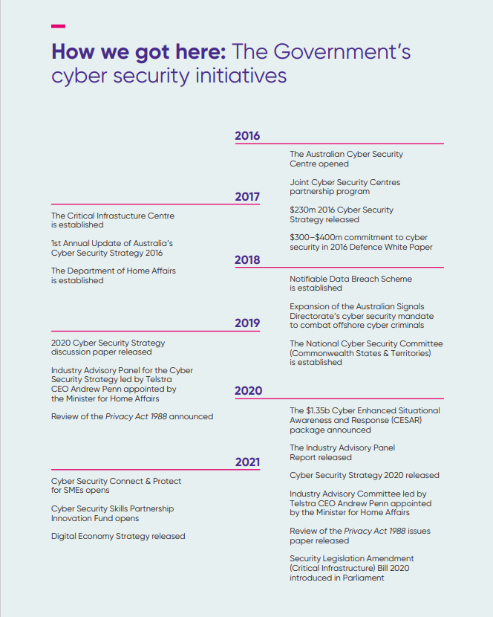
Some key policy documents
Australia’s Cyber Security Strategy to Australia’s Cyber Security Strategy 2020.
Taken from:
The Australian Government discussion paper on options for regulatory reforms and voluntary incentives to strengthen the cyber security of Australia's digital economy, Strengthening Australia's cyber security regulations and incentives.

Slide 6
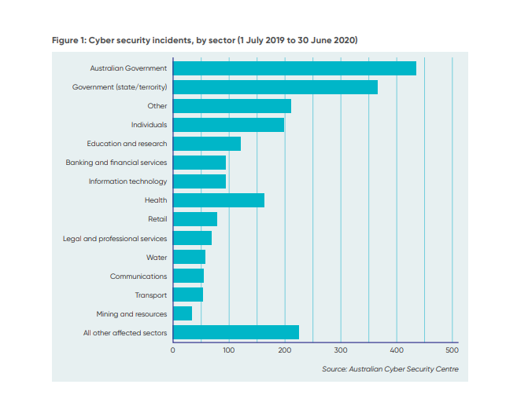
Some key policy documents

Slide 7
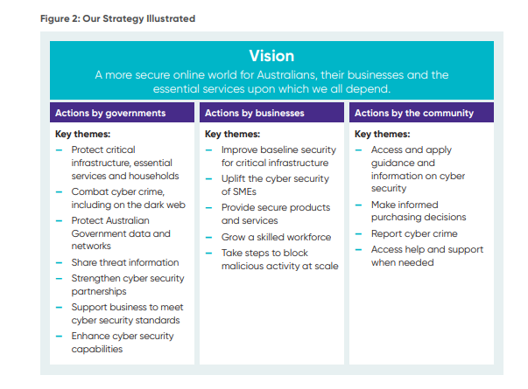
Some key policy documents
Australia’s Cyber Security Cyber Security in a figure

Slide 8
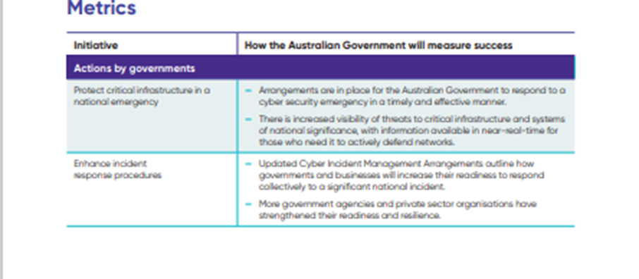
Some key policy documents
Australia’s Cyber Security Cyber Security – Action plan and metrics

Slide 9
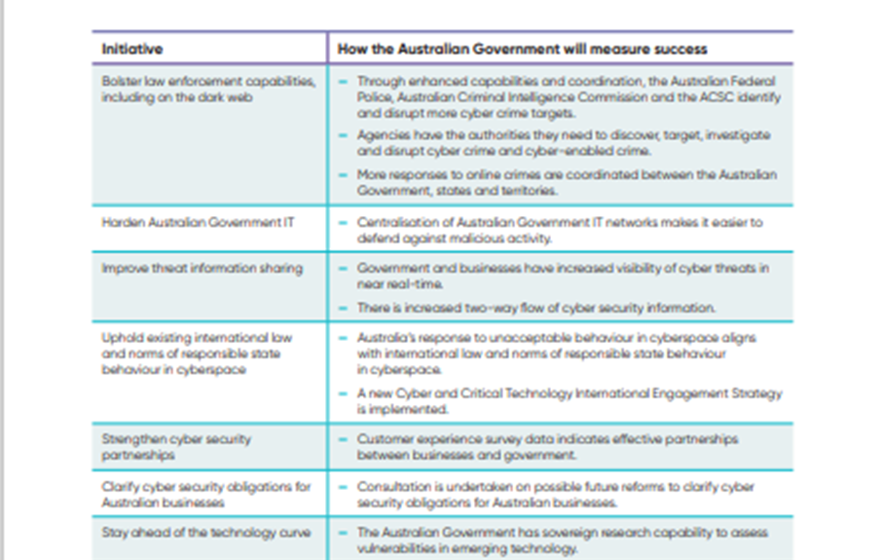
Some key policy documents
Australia’s Cyber Security Cyber Security – Action plan and metrics

Slide 10
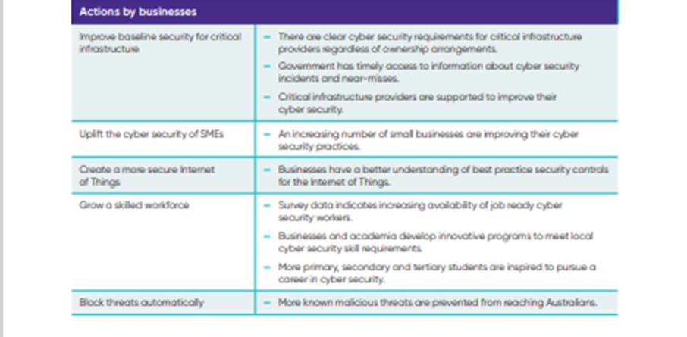
Some key policy documents
Australia’s Cyber Security Cyber Security – Action plan and metrics

Slide 11
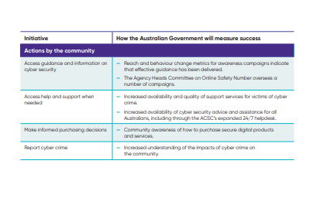
Some key policy documents
Australia’s Cyber Security Cyber Security – Action plan and metrics

Slide 12
Demonstrating the legal patchwork
Irrespective of whether you think of cyber in terms of the law and cyber or cyber law, it is undoubtedly true that a whole host of specific areas of law can apply depending on the circumstances.
This results in a complex weaving of intersection areas of law which may involve the uncertain intersection of statutory and general law (i.e. common law and equity) and international law obligations.

Slide 13
Cybercrime
There was once the image of a hacker as a teenager in his room playing on his computer and causing havoc. The quintessential example here is ‘Mafiaboy’ a Canadian 15 year old who launched a sophisticated denial of service attack that brought down the websites of the likes of Amazon, Yahoo, CNN etc.
These were simpler times to an extent – for instance that 15 year old went on to become a white hat hacker.
So-called ‘hacktivism’ has also emerged with groups getting behind certain causes as activists and then disrupting services to further that cause. Reference here can be made to the hacktivist attacks on Russia following their invasion of the Ukraine.

Slide 14
Cybercrime
More recently, there has been an increasing swell of hacking/use of malware leading to data breaches and there is a complex ecosystem of players including both state and non-state actors, state sponsored actors and private individuals.
For instance, we can look at the Wannacry virus as an example where it is thought that there was State involvement with some attributing the malware that caused ransomware attacks to North Korea.
A clear challenge here is that ‘malware as a service’ operations have emerged meaning that even those with no CS skills can launch sophisticated attacks.
Legally those developing malware may be found to be accessories to the crimes of others. For instance, in the US in 2018 Taylor Huddleston was sentenced to 33 months in prison for selling amongst other things ‘NanoCore RAT’.

Slide 15
Cybercrime
The market for malware operates both relatively openly online but also in a more clandestine manner on the ‘dark web’. Very famous example of an online store where a whole range of elicit goods could be bought was The Silk Road.
Ransomware in particular has received a lot of attention recently given high profile examples but also its impact on SMEs and even micro enterprises and individuals.
The difficulty is that often the perpetrators of the crimes are located in jurisdictions without any extradition treaty with countries like AU.

Slide 16
Cybercrime
The leading international agreement on cybercrime is the Council of Europe Convention on Cybercrime that has been ratified by a number of non-European nations including Australia, US, Canada and Japan.
This Convention recognises the transboundary nature of cybercrime and the need for cooperation and thus collaborative law enforcement.
However, despite the fact that this has been signed by 53 States 8 have failed to ratify including Ireland, Greece and Sweden.

Slide 17
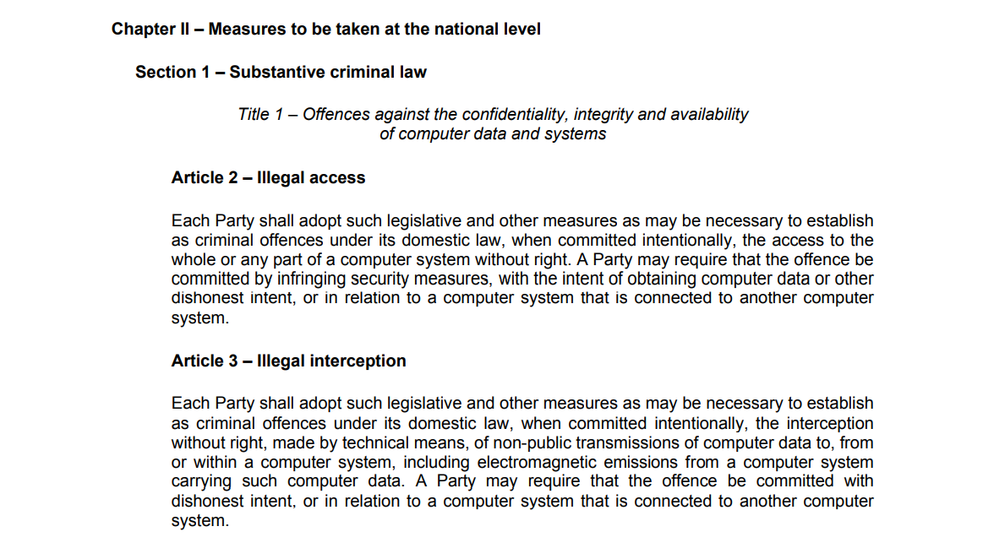
Cybercrime

Slide 18
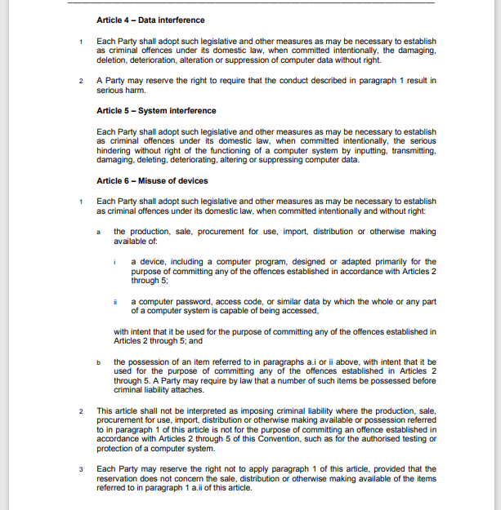
Cybercrime

Slide 19
Cybercrime
“Cybercrime" is regulated under the Criminal Code Act 1995 (Cth): Computer intrusion and unauthorised access to or modification/ destruction of data are offences introduced by Cybercrime Act 2001 (Cth).
This is then supplemented by State and Territory laws that deal with specific issues (e.g. cyber-stalking and harrassment).

Slide 20
Cybercrime
Parts 10.7 and 10.8 of the Criminal Code Act 1995 (Cth) criminalise the following:
Computer intrusions
Unauthorised modification of data, such as the destruction of data
Unauthorised impairment of electronic communications, such as denial of service attacks
Creation and distribution of malicious software (such as malware, viruses and ransomware)
Dishonestly obtaining or dealing in personal financial information

Slide 21
The protection of critical infrastructures
Critical Infrastructures are essential services for the well-being of citizens. Without their adequate protection there would be serious consequences for society. We are dependent on their proper functioning.
However they are vulnerable, natural disasters, criminal or terrorist attacks all have the capacity to disrupt their functioning. These infrastructures range from energy and transport installations, electricity and gas supply and ports and airports.

Slide 22
The protection of critical infrastructures
It must be understood that a key concern in the protection of critical infrastructures is that many of these public assets are in private ownership.
It is not always entirely clear where private sector obligations end and public sector responsibilities begin and this is an important consideration as this privatisation changes the regulatory landscape.
Indeed as observed by Lazari, this private ownership has brought a mix of public duties imposed by legislators and private business interests associated with the protection of a business asset. As a result standards for measuring and counteracting threats as a means of managing risk have been developed.
De Bruijne and van Eeten have noted that despite the fact that these infrastructures are critical for society has not stopped this institutional restructuring resulting in a situation in which governments are increasingly reliant on private parties.
Notes:
Lazari, European Critical Infrastructure Protection, (2014 Springer) 68.

Slide 23
The protection of critical infrastructures
De Bruijne and van Eeten have noted that despite the fact that these infrastructures are critical for society has not stopped this institutional restructuring resulting in a situation in which governments are increasingly reliant on private parties.
A clear difficulty with this situation is that in this institutionally fragmented environment, although all parties may agree that critical infrastructure protection is important, problems arise when it becomes clear that governments expect private sector investment in the security and reliability beyond what it would deem necessary for its business continuity requirements
Notes:
M. De Bruijne and M. van Eeten, ‘Systems that should have failed: Critical Infrastructure Protection in an Institutionally fragmented environment’ (2007) 15 Journal of Contingencies and Crisis Management 18-29.

Slide 24
The protection of critical infrastructures
Aside from the economic interests associated with critical infrastructure protection the private ownership of critical infrastructures also means that cooperation and information sharing is often built on voluntary action as described above.
As observed by Willis et al., this presents certain clear difficulties in relation to the perception that within the private sector there is a concerned about sharing information with the public sector and confidentiality.
This concentrates on the risks associated with making vulnerabilities public, issues concerning liability and the potential for inadvertently highlighting the need for new regulatory mechanisms – for more see: ENISA (2011).
Notes:
H. Willis, G. Lester and G. Treverton, ‘Information sharing for infrastructure risk management: Barriers and solutions (2009) 24 Intelligence and National Security 339-365.
ENISA, ‘A flair for information sharing- encouraging information exchange between CERTs’ (2011) accessed on 01/03/2015 at: http://www.enisa.europa.eu/activities/cert/support/fight-against-cybercrime/legal-information-sharing

Slide 25
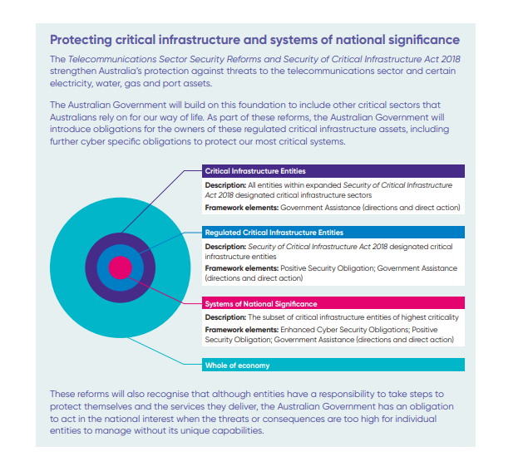
The protection of critical infrastructures
Australia’s Cyber Security Strategy 2020

Slide 26
The protection of critical infrastructures
Australia's law relating to the protection of critical infrastructure are contained in the Security of Critical Infrastructure Act 2018 (Cth).
However, other national infrastructure like telecommunications is subject to its own regulatory regime, such as the Telecommunications Act 1997 (Cth).
It applies to 22 asset classes across 11 sectors including: communications, data storage or processing, defence, energy, financial services and markets, food and grocery, health care and medical, higher education and research, space technology, transport, water and sewerage.

Slide 27
The protection of critical infrastructures
The key elements of the Act are:
A Register of Critical Infrastructure Assets –mandatory
Cyber incident reporting (i.e. to the Australian Cyber Security Centre’s online cyber incident reporting portal)
Government Assistance (i.e. in the event of a serious event and only as a last resort).
The Secretary of the Department of Home affairs power to obtain more detailed information
The Minister for Home Affairs will can direct an owner or operator of critical infrastructure to do, or not do, a specified thing to mitigate against a national security risk where all other mechanisms to mitigate the risk have been exhausted.

Slide 28
The protection of critical infrastructures
Given the strategic importance of CIs it is reasonable to consider the risks associated with attacks. There are clear risks associated with the disruption of a CI’s operation.
Attacks motivated from a cyber-espionage perspective by their very nature however, may not always aim to directly disrupt or damage the CI but instead may target the retrieval of particular types of information (e.g. power grid mapping in the energy sector).
If these attacks are targeted towards systems containing personal information then the Data Protection/Privacy may be applicable. Moreover, during the threat detection and assessment stage, if personal information is processed in order to successfully analyse and counteract the attacks the Data Protection/Privacy also legislation needs to be kept in mind.

Slide 29
Cyber Security and law enforcement, national security and cyber warfare
Korff describes how law enforcement, national security agencies and other agencies rely on the same techniques as cyber-criminals/cyber-terrorists and that these actions are legitimised through law.
There is nothing unusual about for as for example police powers to enter a premises a detain someone are permitted but only under strict conditions.
Authors such as Korff however, are critical of the controls that exist over the exercising of such powers as they effectively amount of hacking and are therefore, potentially invasive but have been treated different in legislation.
Indeed, Korff in particular points to the blurring roles of what were once very clearly delineated agencies. To clarify, national security agencies gaining more powers and responsibilities to investigate serious crimes such as terrorism and law enforcement gaining more intelligence gathering powers.
Notes:
Korff, Douwe, Harm Caused to Fundamental Rights and Freedoms by State Cybersecurity Interventions (November 28, 2016). Available at SSRN: https://ssrn.com/abstract=3709808 or http://dx.doi.org/10.2139/ssrn.3709808

Slide 30
Data protection/privacy law
Federal Legislation | Sector Specific Legislation | State Level Legislation
Privacy Act 1988 | Telecommunications (Interception and Access) Act 1979 Telecommunications (Interception and Access) Amendment (Data Retention) Act 2015 | Victoria: Health Records Act 2001, Privacy and Data Protection Act 2014, ACT: Health Records (Privacy and Access) Act 1997; NSW: Health Records and Information Privacy Act 2002, Privacy and Personal Information Protection 1998,
Australian Consumer Law | Spam Act 2003 | NT: Information Act 2002, Tasmania: Personal Information Protection Act 2004, QL: Information Privacy Act 2009
 | My Health Records Act 2012 | Victoria: Surveillance Devices Act 1999, NSW: Surveillance Devices Act 2007, Workplace Surveillance Act 2005 Victoria: Crimes Act eg, assault, s 21A (stalking) Summary Offences Act s. 41DA (sexting)

Slide 31
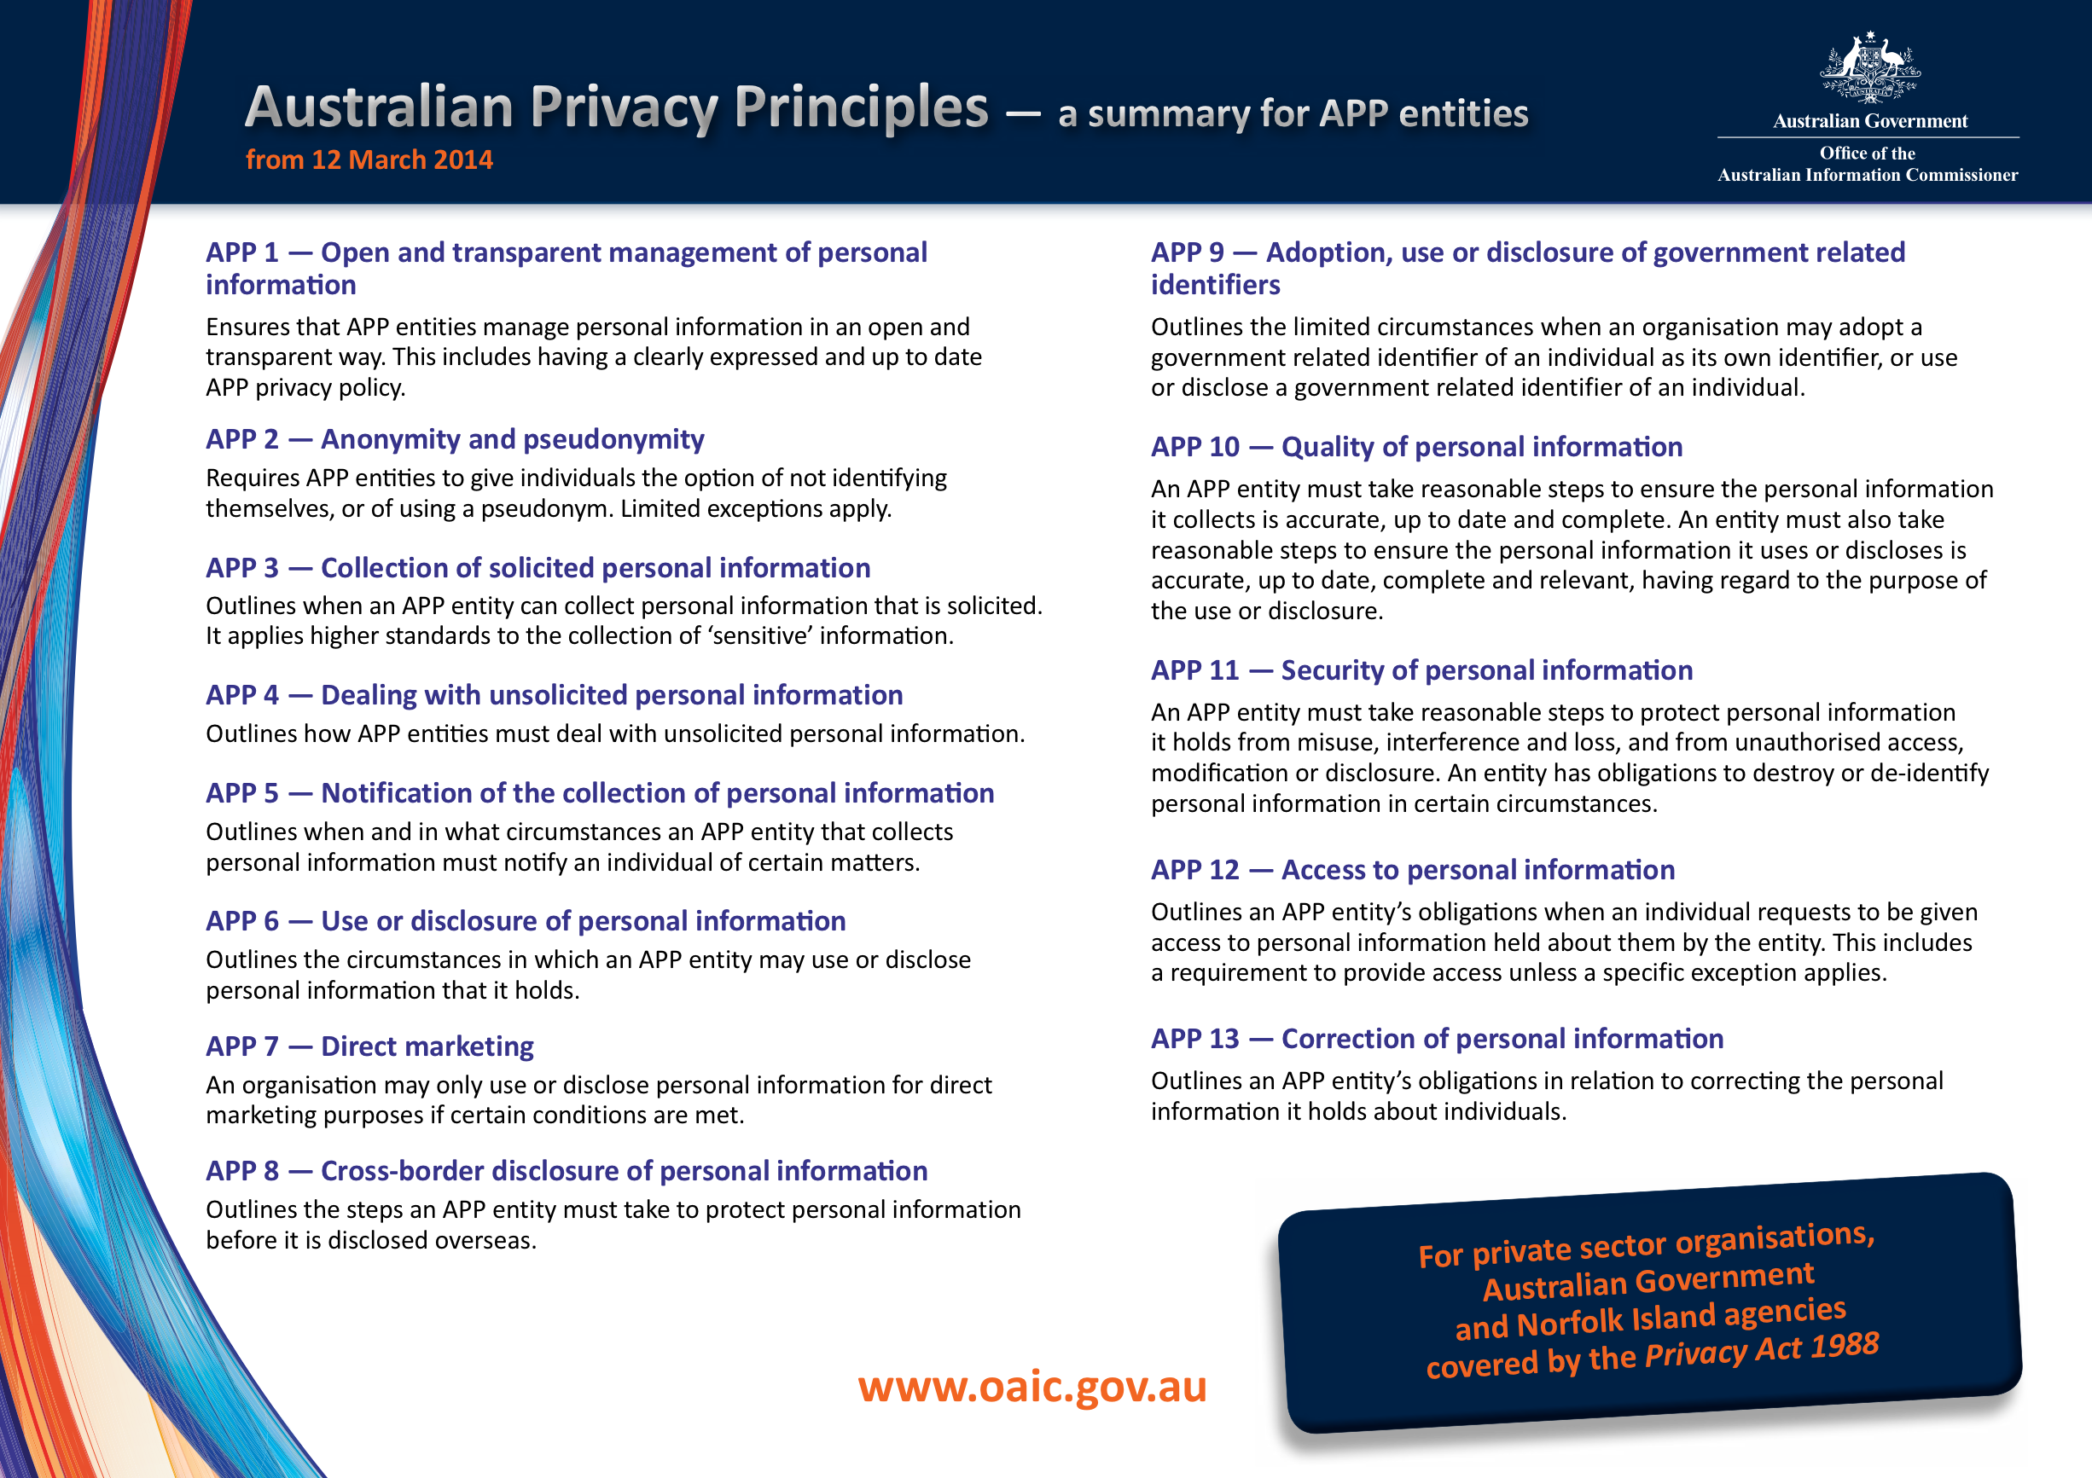

Slide 32
APP 11 – Security of personal information
APP 11.1 – An APP entity that holds personal information must take reasonable steps to protect the information from misuse, interference and loss, as well as unauthorised access, modification or disclosure.
APP 11.1 – An APP entity must take reasonable steps to destroy or de-identify the personal information it holds once the personal information is no longer needed for any purpose for which the personal information may be used or disclosed under the APPs. This requirement does not apply where the personal information is contained in a Commonwealth record or where the entity is required by law or a court/tribunal order to retain the personal information.

Slide 33

The Notifiable Data Breaches (NDB) scheme – Privacy Act
Part IIIC of the Privacy Act requires entities to notify (affected individuals and the Commissioner) about ‘eligible data breaches’.
An eligible data breach occurs when the following criteria are met:
There is unauthorised access to or disclosure of personal information held by an entity (or information is lost in circumstances where unauthorised access or disclosure is likely to occur).
This is likely to result in serious harm to any of the individuals to whom the information relates.
The entity has been unable to prevent the likely risk of serious harm with remedial action.
Entities must also conduct an assessment if it is not clear if a suspected data breach meets these criteria. The assessment will determine whether the breach is an ‘eligible data breach’ that triggers notification obligations.

Slide 34
Other reporting obligations
For data breaches affecting certain categories of information, other mandatory or voluntary reporting schemes may exist. For example, entities might consider reporting certain breaches to:
the entity’s financial services provider
police or law enforcement bodies
the Australian Securities & Investments Commission (ASIC)
the Australian Prudential Regulation Authority (APRA)
the Australian Taxation Office (ATO)
the Australian Transaction Reports and Analysis Centre (AUSTRAC)
the Australian Cyber Security Centre (ACSC)
the Australian Digital Health Agency (ADHA)
the Department of Health
State or Territory Privacy and Information Commissioners
Professional associations and regulatory bodies
Insurance providers

Slide 35
Commercial contracts
Contract law a form of private law-making for large corporations. This relates to the fact that terms are often standard form with a range of additional policies then just linked to.
There are a variety of contracts that intersect with cyber security issues. For instance contracts for cloud services, for managed services, for solution development/integration and for off the shelf hardware or software.
Despite the fact that negotiation may be difficult on many issues, with the right amount of leverage often there can be some negotiation on quality of the service (i.e. what’s included), price/payment, remedies, and certain variables which might include certain guarantees regarding security (e.g. no overseas storage).

Slide 36
Commercial contracts
Who controls the security risks? (vendors of technological solutions, their supply chain and customers)
How do you divide responsibility? Think about the role of commercial and consumer contracts here for instance.
Complexity is a big issue here.

